Slide 1
UX Guide Stakeholder Needs
Assessment Project
Final Report
Alaina Wood, BAC HFE Lead
David Clarke, BAC Team Lead, Project Manager
12/12/2019

Slide 2
Roadmap
Objectives
General Methodology
UX Guide Purpose/Vision
Stakeholder Interview Findings
Environmental Scan Findings
Completed Steps
Next Steps: Proposed Plan

Slide 3
Objectives
Purpose
Transfer Knowledge - from the UX Guide product manager to the BAC team to understand what UX work as already been achieved and understand future objectives.
Interview Stakeholders - to understand their vision, intended user groups, and content to be included in the UX Guide.
Conduct Environmental Scan - to identify potential content for the UXG.
Review backlog of UXG projects to assess prioritization.

Slide 4
Objectives
Activities
Review the current UXG website for content and architecture.
Attend a demo of the content delivery system and discuss previous initiatives.
Conduct interviews with the UXG product manager.
Conduct a preliminary environmental scan.
Conduct interviews with five (5) UXG stakeholders.

Slide 5
General Methodology
Knowledge Transfer – Review UXG Objectives
Reviewed the current UXG website to familiarize ourselves with the navigations, workflows, and content.
Participated in two remote sessions, each an hour in length with the UXG Product Manager. The sessions covered:
The vision and objectives for the UXG
The history and current status of the UXG
A demo of the content delivery system
Potential new features/requirements

Slide 6
General Methodology
Knowledge Transfer – UXG Website Infrastructure
Performed a technical review of the current UXG WordPress site. Explored content presentation, site navigation and site features.
Reviewed the new “Divi” WordPress theme and “Pods” plugin.
Performed a gap analysis comparing the business and technology requirements against the functionality available in the new WordPress theme.

Slide 7
General Methodology
Stakeholder Interviews
Five (5) stakeholders were recruited to participate in a 30-minute interview session via Skype.
The stakeholders represented various departments and specialties in the VHA:
CIDMO program office
Clinical Decision Support
National Center for Patient Safety
Office of Connected Care
Community of Practice

Slide 8
General Methodology
Environmental Scan
An environmental scan was conducted of academic and grey literature.
Relevant keywords were used such as “usability”, “safety”, “human factors”, “electronic health records”, “EHR”, “implementation”, “training”, “configuration”, and “customization.”
Resources were reviewed for inclusion.
Additionally, resources identified by or made available through specific, targeted organizations such AHRQ, EHRA, HIMSS, HRSA, RECs, and AMA were reviewed and included where relevant.

Slide 9
UX Guide Purpose/Vision
The VHA is focused on building a stronger informatics workforce.
The UX Guide will serve as a central place where users can go to share information and resources such as instructional guides, case studies, tools, and techniques, that will aid in building a connected informatics network.
Human Factors is leading the UX Guide, however this is a HIT initiative under CIDMO, and will be promoted as an organization-wide effort.

Slide 10
UX Guide Purpose/Vision
The UXG will serve as a mechanism to promote Human Factors and HCD within the VHA.
The UXG will serve as a well moderated body of knowledge that will help users adopt human-centered design practices within the VHA.

Slide 11
Stakeholder Interview Findings
General Findings
Employees from various roles across the VA are willing to contribute to the effort of creating a UX Guide.
There are several roles within the VA that are not plugged into the informatics side. The UXG will serve the purpose of educating these roles about HF and encouraging and supporting the use of human-centered design practices.
Central location where people can learn best practices. Resources should be available for those just getting started with usability- to experienced HF professionals looking to share and collaborate.

Slide 12
Stakeholder Interview Findings
General Findings
Every stakeholder commented that there is currently no sufficient platform to collaborate and share resources within the VHA.
Several departments use SharePoint; however individuals also use Pulse, individual drives, and other storage/sharing solutions.
Several departments used Yammer to communicate and collaborate, however Yammer was decommissioned.

Slide 13
Stakeholder Interview Findings
General Findings
Having a central place to make tools available (such as personas and scenarios) and shared resources (such as case studies) would be a huge benefit.
Departments often work in silos, repeating work efforts.
Room for improvement with how teams communicate.
A central collaborative space will help build an integrated informatics community, rather than isolated silos.

Slide 14
Stakeholder Interview Findings
General Findings
The UXG is not intended to re-event the wheel. Work that others have completed will be curated and shared.
There is a current initiative within the VA to create a Health Informatics Community of Practice.
A collaborative website is being created for this community.
The BAC team will explore ways that the UXG can support or integrate with this effort.
The UXG can be used as a tool during training sessions.
The training sessions will be a great opportunity to get feedback on the UXG as it is being developed.

Slide 15
Stakeholder Interview Findings
Intended User Groups of the UX Guide:
As per discussions, the first user group for the UX Guide will be CACs (Clinical Application Coordinators).
Additional User Groups:
Other users with a clinical informatics background (Clinical informaticists, CHIO’s)
Users working at the facility (System Coordinators, Quality Improvement Personnel)
Informatic Students (Learners)
Patient Safety Personnel (Patient Safety Officers)
System Re-design Coordinators

Slide 16
Stakeholder Interview Findings
Potential UXG Content:
Personas and Scenarios (including mental health patient personas and personas for each role on a mental health team)
Service Blueprints (incl. patient journey maps)
Shared vocabulary (to define domain specific concepts among VA organizations and among related roles)
HFE methods, tools, and techniques (and how tools/ techniques can be used together)
Human resource component– designated resources for HFE activities

Slide 17
Stakeholder Interview Findings
Potential UXG Content:
Training content (may include instructional guides, videos, e-learning, etc.)
Completed projects (such as the Echocardiogram Workstation Integration Clinical Usability Study, case studies, etc.)
Usability Toolkit Artifacts
Patient Safety initiatives (risk analysis document, guidebook, etc.)
Information integration with the Health Informatics Community of Practice

Slide 18
Environmental Scan Findings
Refer to separate deliverable for list of findings for preliminary environmental scan.
Nine (9) resources were identified in the environmental scan that should be reviewed for identifying relevant UXG content.
Resources were reviewed and content was placed in one of two categories:
UXG should describe and link to content found.
Content needs to be synthesized prior to referencing in UXG

Slide 19
Environmental Scan Findings
UXG should describe and link to content
Four (4) resources were identified:
ONC Change package for Improving EHR Usability
General Design Principles for EHRs
EHR Usability Toolkit: A Background Report on Usability and Electronic Health Records
Understand Unintended Consequences

Slide 20
Environmental Scan Findings
Five (5) resources were identified which has relevant content but needs to be synthesized to include in UXG:
2015 Edition Test Method
Safe Practice Recommendations for Copy and Paste
Identification and Prioritization of HIT Patient Safety Measures
Promoting Usability in Health Organizations: Initial Steps and Progress Toward a Healthcare Usability Maturity Model
EMR Usability Evaluation RFP for Clinicians Practices

Slide 21
Environmental Scan Findings
Online examples for key UX guide content types were also identified:
Fifteen (15) content libraries were identified
Twelve (12) Playbooks
Ten (10) education and role-based training modules
NOTE: Some content fit into more than one content type.

Slide 22
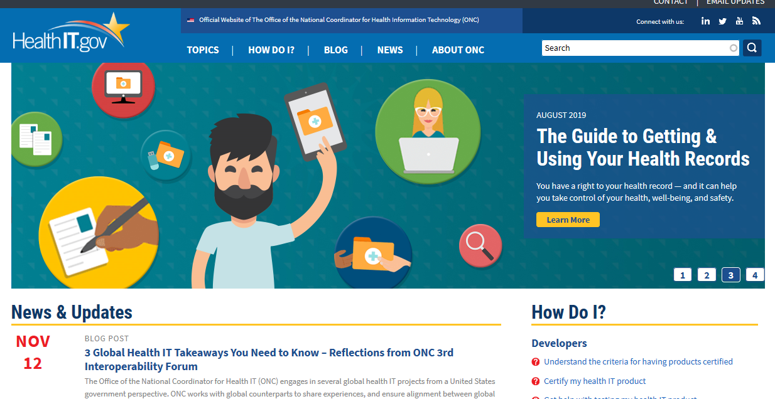
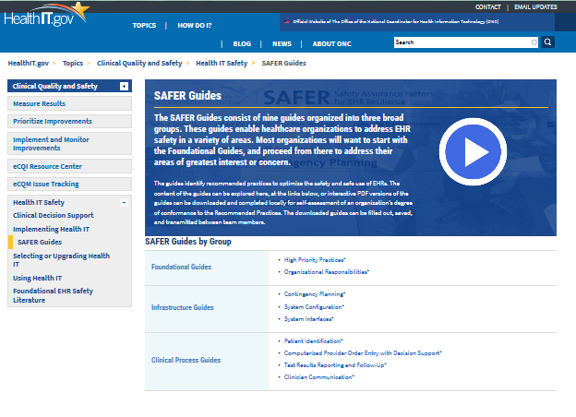
Environmental Scan Findings
Example finding: HealthIT.gov
HealthIT.gov

Slide 23
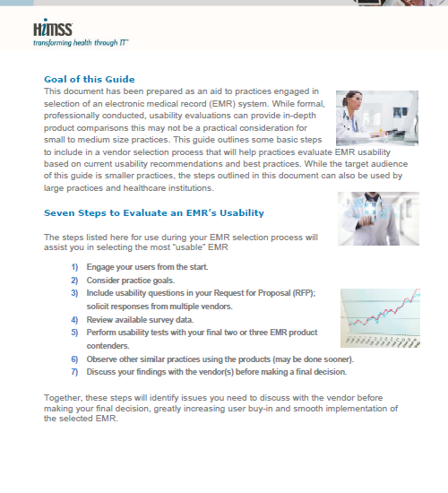
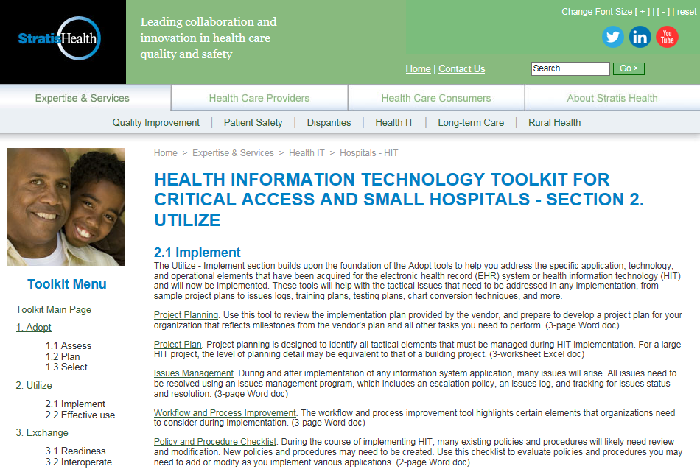

Environmental Scan Findings
Example findings: Playbooks and Toolkits

Slide 24
Next Steps: Proposed Plan
Release 1
User Testing
Release 3
Develop/Update New Content
Release 2
CMS (WordPress) configuration
User requirements gathering – First user group CACs
Convert existing content to new theme
Install/configure plugins
Visual design/layout of pages
Information architecture
UXG terminology
Key HCD concepts
Curate content for v2
Design site to meet the needs of intended users
Update with new content
Conduct user testing – 6 users
Revise site based on findings
Data Analytics
Develop marketing strategy
UXG Maintenance
Support an information architecture
Develop content management system
Distribute and promote UXG
Site usage and analytics
Create content management plan
Support content curation
Perform ongoing site testing
Perform ongoing WordPress and Plugin updates
Each stage 4-6 weeks

Slide 25
Next Steps: Proposed Plan
Develop Website – Release 1 (R1)
CMS (WordPress) Configuration (Divi)
Assess and integrate current content
Develop/Update New Content
User Requirements Gathering
Information Architecture
UXG Terminology
Key HCD Concepts
Curate content to be included for R2 - methods, tools, techniques, Play Books, Tool Kits, etc.

Slide 26
Next Steps: Proposed Plan
Develop Website – Release 2 (R2)
User Testing of R1
Assess site navigation, finding content, and content value
Apply design changes to website
Update website with new content
Enhance and integrate additional content
Text, images, video

Slide 27
Next Steps: Proposed Plan
Develop Website – Release 3 (R3)
User Testing of R2
Assess site navigation, finding content, and content value
Apply design changes to website
Update website with new content
Enhance and integrate additional content
Text, images, video
Integrate Site Usage/Data Analytics
UXG Maintenance strategy

Slide 28
Next Steps: Plan Details
Develop Website – R1
CMS (WordPress) Configuration
Use new Divi theme and convert all existing UXG content to new theme
Install and/or configure plugins to provide any features/functionality not provided in Divi theme
Visual Design/layout of page types: ‘article’ page, list pages, home page.
Start information Architecture

Slide 29
Next Steps: Plan Details
Develop/Update New Content
Identify and prioritize UXG user groups (assume CAC is target user group)
Capture and refine users' goals
Complete a competitive analysis of other sites with similar goals as the UXG - note best practices
Define requirements for images and videos and ramifications of using licensed content.
Identify and specify user research activities needed to translate user goals into specific (measurable) objectives that will inform new content and capabilities

Slide 30
Next Steps: Plan Details
2. Continued…
Perform a content inventory to document the current content on the site.
Create a site map that proposes a site structure to best meet the needs and goals of the UXG
Create wireframes and/or interactive prototypes and conduct discovery user testing with 6 potential users to validate site map
Revise the site map based on findings (include two rounds of revisions based on user feedback)

Slide 31
Next Steps: Plan Details
2. Continued…
Assemble a committee of HFE representatives within the VHA. Committee will participate in reviewing and selecting UXG terms/definitions as well as identifying key HCD concepts to be included in the UXG
Define HFE terminology that will be used across VA organizations and among related roles
Develop a schema for organizing concepts based on anticipated information needs of a HIS project team wanting to apply an HCD process

Slide 32
Next Steps: Plan Details
3. Develop Website – R2
Design the user interface to meet the needs of intended users
Support an information architecture (including specifications for structured and unstructured metadata)
Update website with new content (text, images, video)
Develop a content management process – who will have authority to upload, edit, etc. content to site

Slide 33
Next Steps: Plan Details
4. User Testing
User test the newly configured UXG (R2) with 6 potential users to validate design, navigation, and content value
Apply findings to complete designs for R3

Slide 34
Next Steps: Plan Details
5. Launch Website – R3
Launch and distribute UXG R3
Develop a distribution and marketing strategy to promote the new UX Guide

Slide 35
Next Steps: Plan Details
6. Data Analytics
Provide site usage analytics data to measure the impact of the UXG and prioritize new work activities.

Slide 36
Next Steps: Plan Details
7. UXG Maintenance
Create a content management plan
Support content curation: including intake, quality assurance, publication, and usage monitoring of UXG content
Versioning – as new work continues updating the site
Perform ongoing site testing (e.g., broken links)
WordPress and plugin updates

